Slide 1
SQL PROJECT
IPL AUCTION

Slide 2
1.Bidding on batters
Your first priority is to get 2-3 players with high S.R who have faced at least 500 balls.And to do that you have to make a list of 10 players you want to bid in the auction so that when you try to grab them in auction you should not pay the amount greater than you have in the purse for a particular player.
Aggresive_Batsmen
SQL QUERY
select batsman,balls_faced,round(total_runs_scored,2) as total_runs,
round((total_runs_scored/balls_faced)*100,2) as strike_rate
from(select batsman,count(batsman) as balls_faced, sum(batsman_runs)/1.0 as total_runs_scored
from ipl_ball
group by batsman)
where balls_faced>=500
order by strike_rate desc
limit 10;

Slide 3
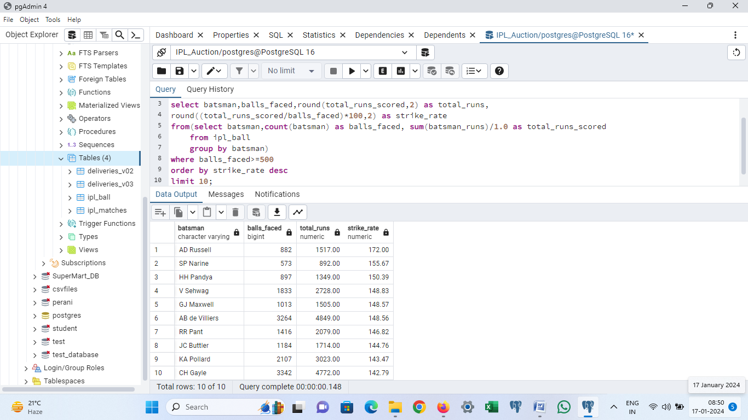

Slide 4
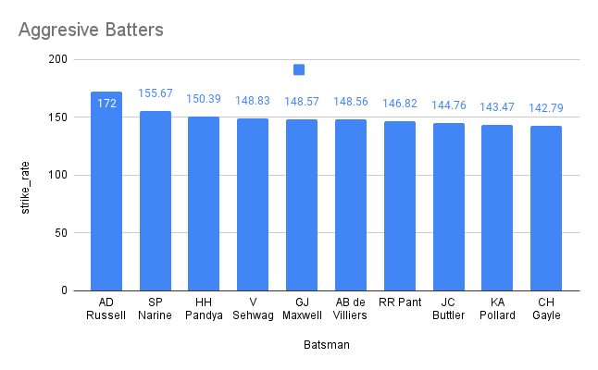

Slide 5
Now you need to get 2-3 players with good Average who have played more the 2 ipl seasons.And to do that you have to make a list of 10 players you want to bid in the auction so that when you try to grab them in auction you should not pay the amount greater than you have in the purse for a particular player.
Anchor_Batsmen
SQL QUERY
select batsman,count(distinct year)as number_of_seasons,sum(batsman_runs) as total_runs,sum(dismissed_times) as dismissed_times,
round((sum(batsman_runs)*1.0/sum(dismissed_times)),2)as average_runs
from
(select b.batsman as batsman,extract(year from a.date) as year,b.batsman_runs as batsman_runs,b.is_wicket as dismissed_times
from ipl_matches as a join ipl_ball as b
on a.id=b.id )
group by batsman
having count(distinct year)>2
order by average_runs desc
limit 10;

Slide 6
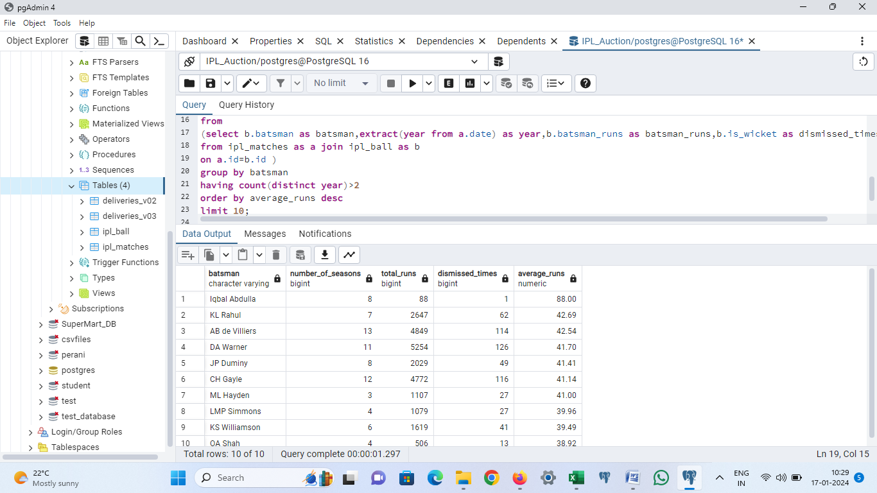

Slide 7
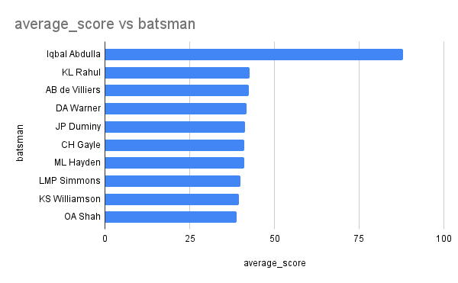

Slide 8
Now you need to get 2-3 Hard-hitting players who have scored most runs in boundaries and have played more the 2 ipl season. To do that you have to make a list of 10 players you want to bid in the auction so that when you try to grab them in auction you should not pay the amount greater than you have in the purse for a particular player.
SQL QUERY
Hard-Hitting-Players
select batsman,number_of_seasons,boundary_runs,total_runs,
(case when total_runs=0 then 0
else round(boundary_runs*1.0/total_runs*100,2) end) as boundary_percentage
from
(select
b.batsman as batsman,
count(distinct extract(year from a.date))as number_of_seasons,
sum(case when b.batsman_runs=4 then 4
when b.batsman_runs=6 then 6
else 0 end) as boundary_runs,
sum(b.batsman_runs) as total_runs
from ipl_matches as a
join ipl_ball as b
on a.id=b.id
group by batsman)
where number_of_seasons>2
order by boundary_percentage desc,boundary_runs desc
limit 10;

Slide 9
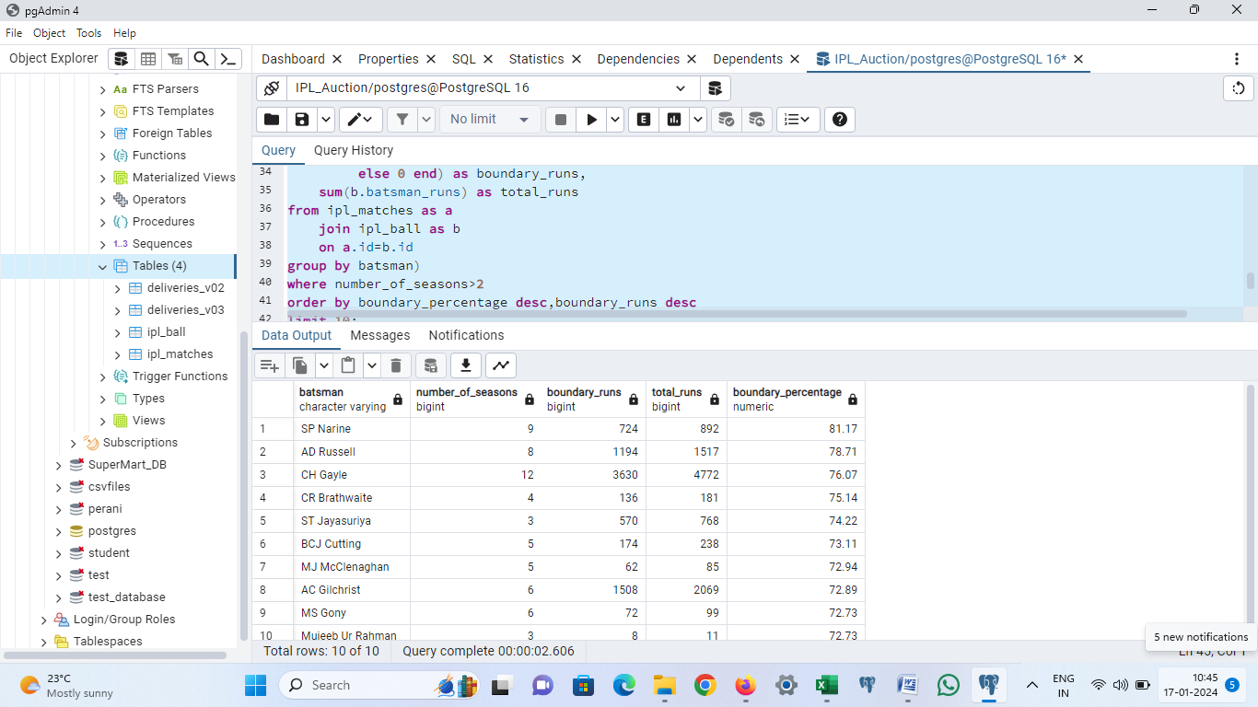

Slide 10
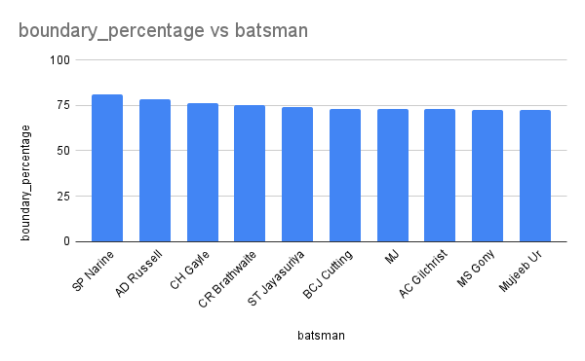

Slide 11
2.Bidding On Bowlers
Your first priority is to get 2-3 bowlers with good economy who have bowled at least 500 balls in IPL so far.To do that you have to make a list of 10 players you want to bid in the auction so that when you try to grab them in auction you should not pay the amount greater than you have in the purse for a particular player.
Good Economy Bowlers
SQL QUERY
select bowler,
round(sum(total_runs)/(count(bowler)/6.0),2) as economy
from ipl_ball
group by bowler
having count(bowler)>=500
order by economy
limit 10;

Slide 12
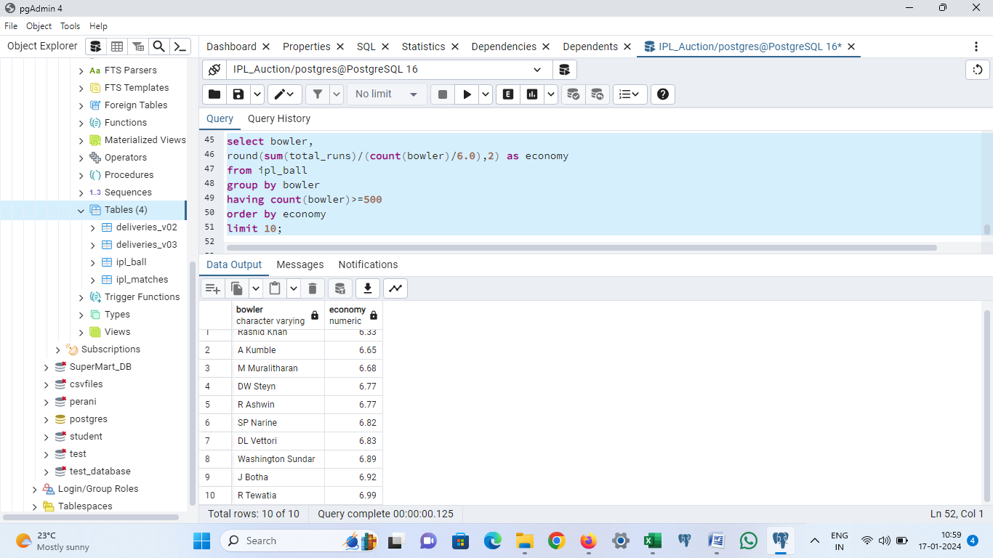

Slide 13
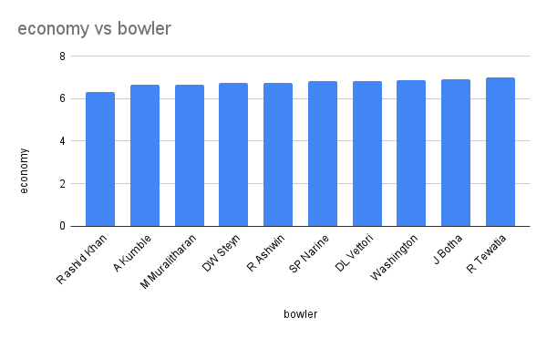

Slide 14
Now you need to get 2-3 bowlers with the best strike rate and who have bowled at least 500 balls in IPL so far.To do that you have to make a list of 10 players you want to bid in the auction so that when you try to grab them in auction you should not pay the amount greater than you have in the purse for a particular player.
Bowlers with Best Strike Rate
SQL QUERY
select bowler as bowler_name,
count(bowler) as total_balls,
sum(is_wicket) as total_wickets,
(count(bowler)/sum(is_wicket)) as strike_rate
from ipl_ball
group by bowler_name
having count(bowler)>=500
order by strike_rate
limit 10;

Slide 15
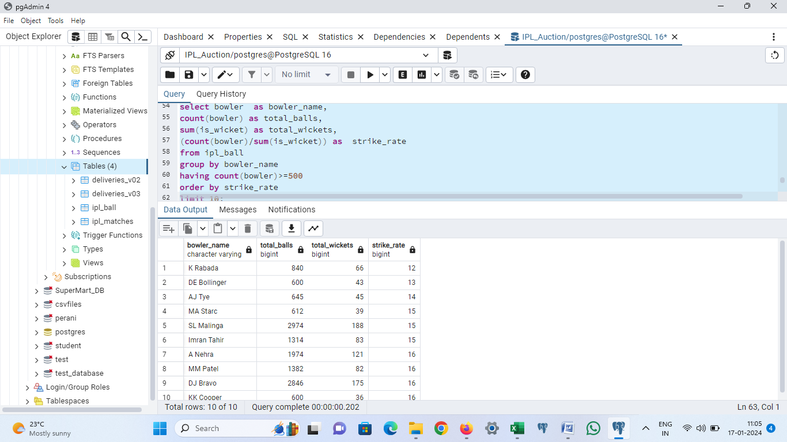

Slide 16
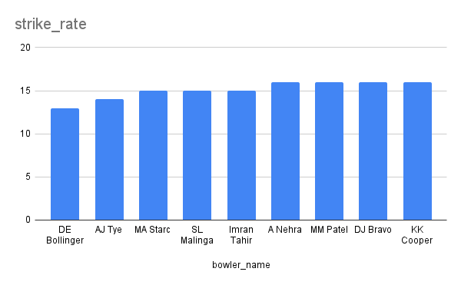

Slide 17
Now you need to get 2-3 All_rounders with the best batting as well as bowling strike rate and who have faced at least 500 balls in IPL so far and have bowled minimum 300 balls.To do that you have to make a list of 10 players you want to bid in the auction so that when you try to grab them in auction you should not pay the amount greater than you have in the purse for a particular player.
All Rounders
SQL QUERY
select batsman as all_rounder,
round((sum(batsman_runs)*1.0/count(ball) *100),2) as batsman_strike_rate,
bowler_strike_rate
from ipl_ball as a
inner join
(select bowler,
count(bowler) as number_of_balls,
sum(is_wicket) as total_wicket,
round(((count(bowler)*1.0/sum(is_wicket))),2)as bowler_strike_rate
from ipl_ball
group by bowler
having count(bowler)>300
order by bowler_strike_rate asc) as b
on a.batsman = b.bowler
group by batsman,bowler_strike_rate

Slide 18
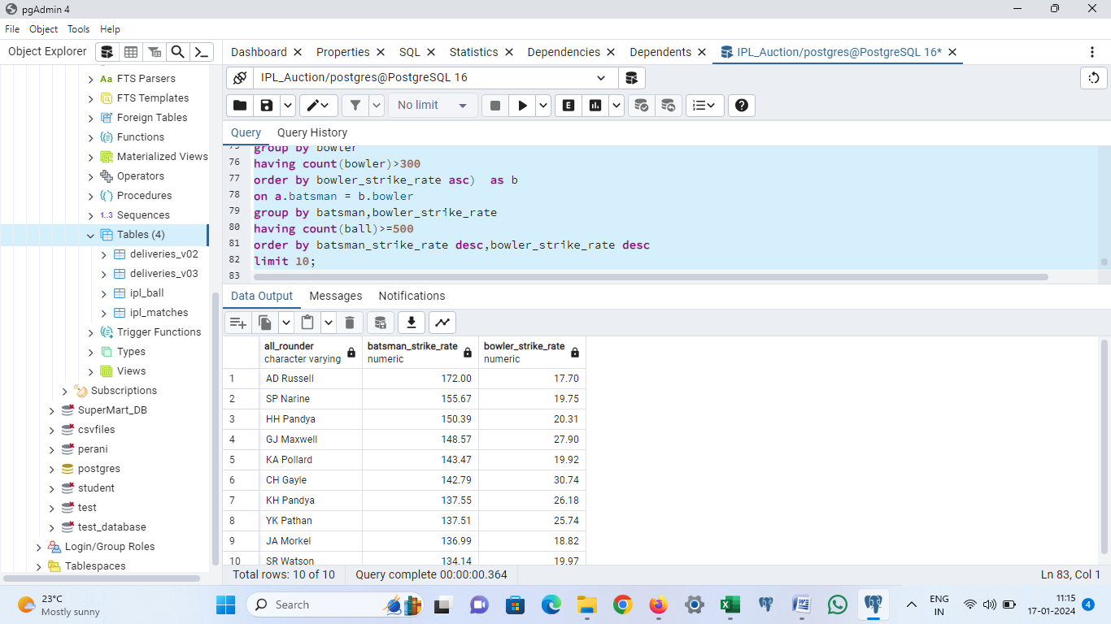

Slide 19
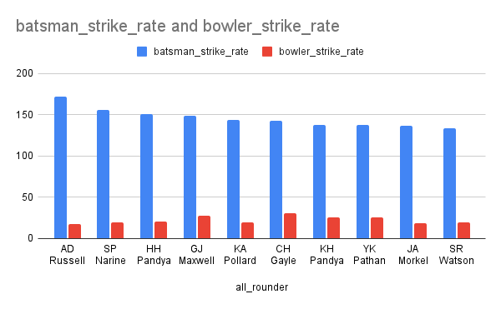

Slide 20
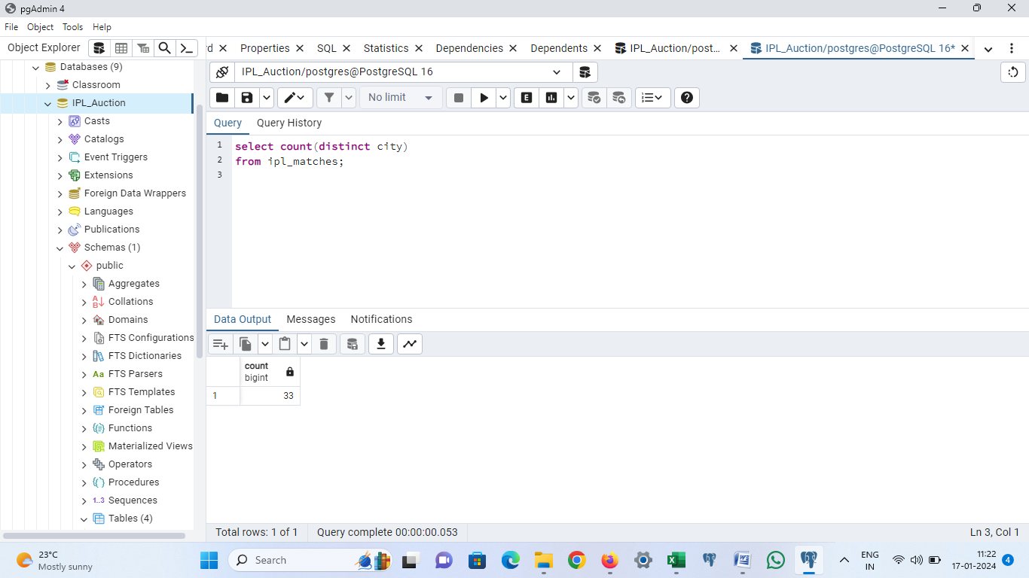
Additional Questions for Final Assessmen
1.Get the count of cities that have hosted an IPL match
select count(distinct city)
from ipl_matches;

Slide 21
2.Create table deliveries_v02 with all the columns of the table ‘deliveries’ and an additional column ball_result containing values boundary, dot or other depending on the total_run (boundary for >= 4, dot for 0 and other for any other number)
create table deliveries_v02 as
(select id,inning,over,ball,batsman,non_striker,bowler,batsman_runs,
extra_runs,total_runs,is_wicket,dismissal_kind,player_dismissed,fielder,
extras_type,batting_team,bowling_team,
(case when total_runs>=4 then 'boundary'
when total_runs=0 then 'dot'
else 'other' end)as ball_result
from ipl_ball);

Slide 22
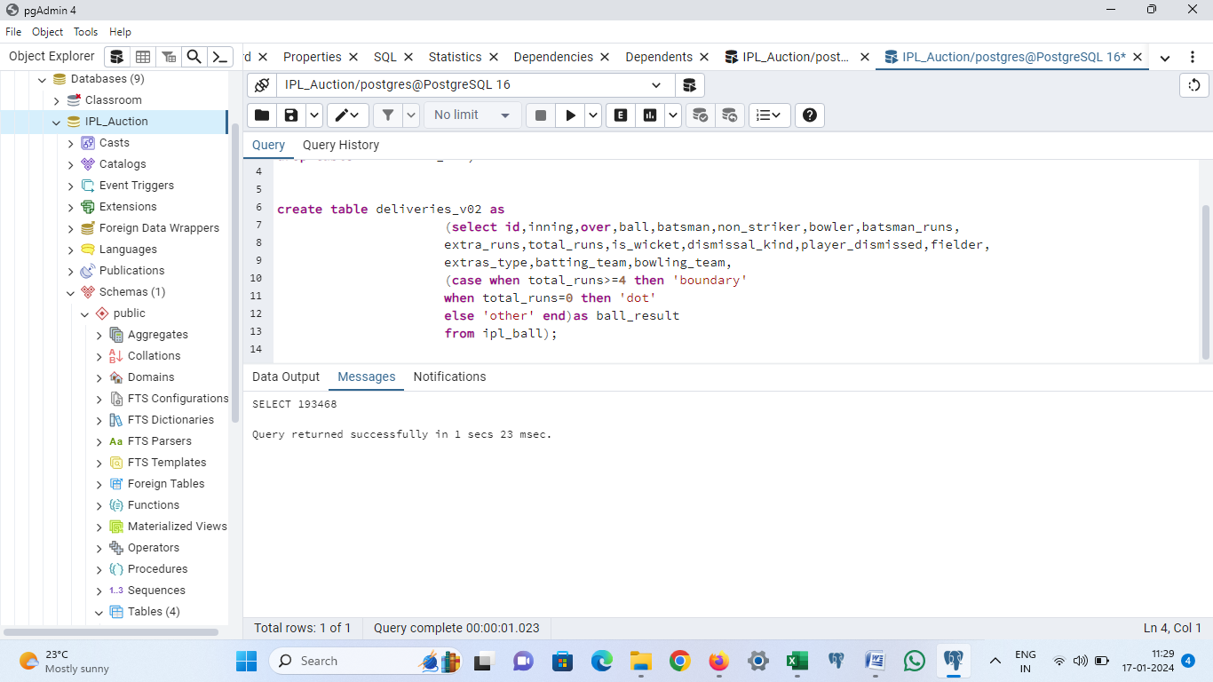

Slide 23
3. Write a query to fetch the total number of boundaries and dot balls from the deliveries_v02 table.
SELECT
COUNT(CASE WHEN ball_result ='boundary' THEN 1 END) AS total_boundaries,
COUNT(CASE WHEN ball_result='dot' THEN 1 END) AS total_dot_balls
FROM
deliveries_v02;

Slide 24
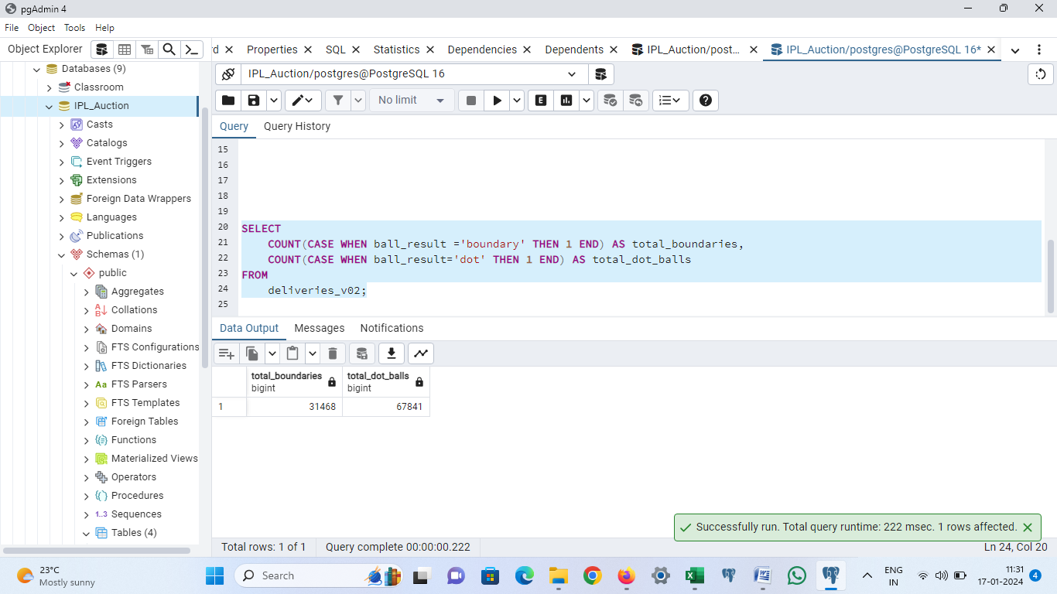

Slide 25
4.Write a query to fetch the total number of boundaries scored by each team from the deliveries_v02 table and order it in descending order of the number of boundaries scored.
select
batting_team,
count(case when ball_result ='boundary' then 1 end) as total_boundaries
from
deliveries_v02
group by batting_team
order by total_boundaries desc;

Slide 26
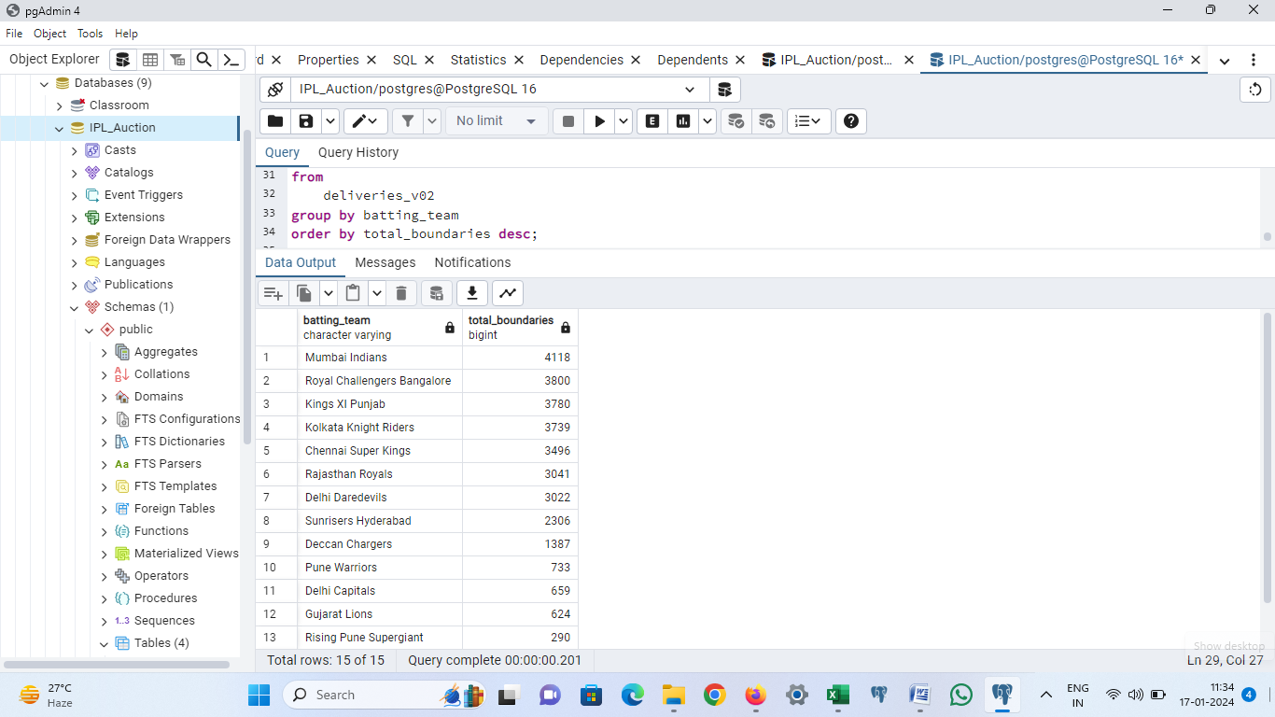

Slide 27
5.Write a query to fetch the total number of dot balls bowled by each team and order it in descending order of the total number of dot balls bowled
select
bowling_team,
count(case when ball_result ='dot' then 1 end) as total_dot_balls
from
deliveries_v02
group by bowling_team
order by total_dot_balls desc;

Slide 28
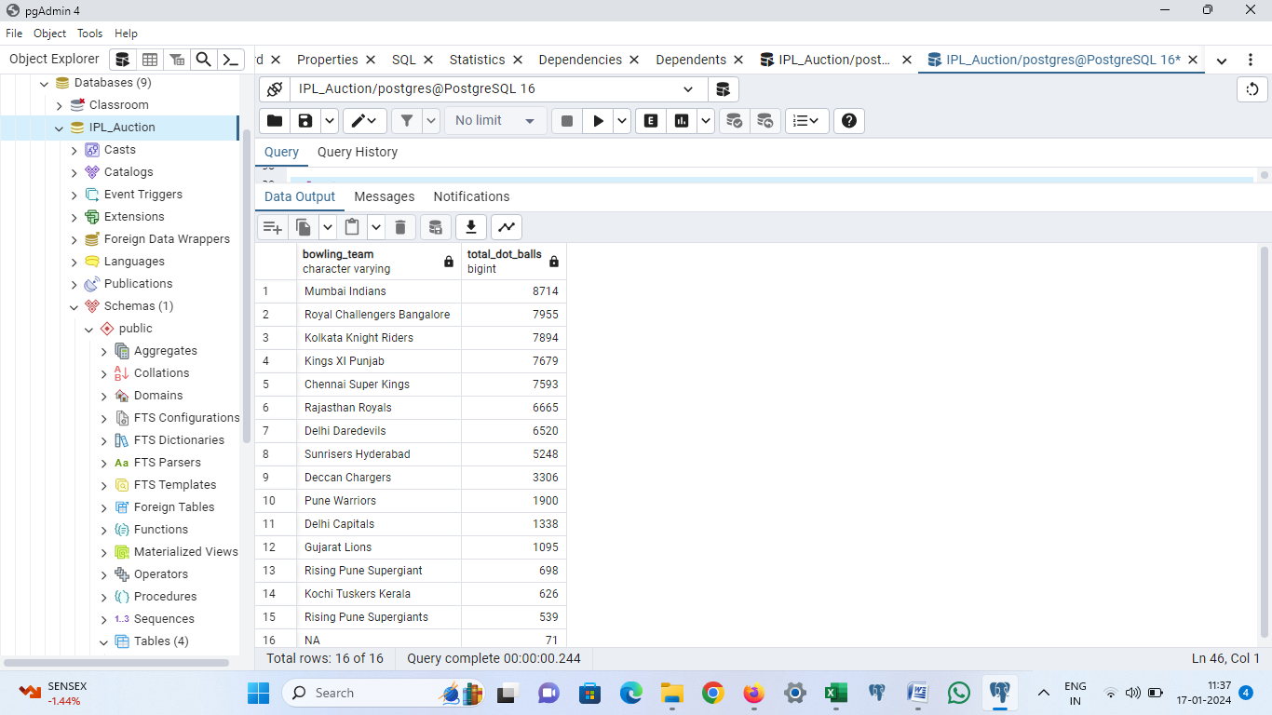

Slide 29
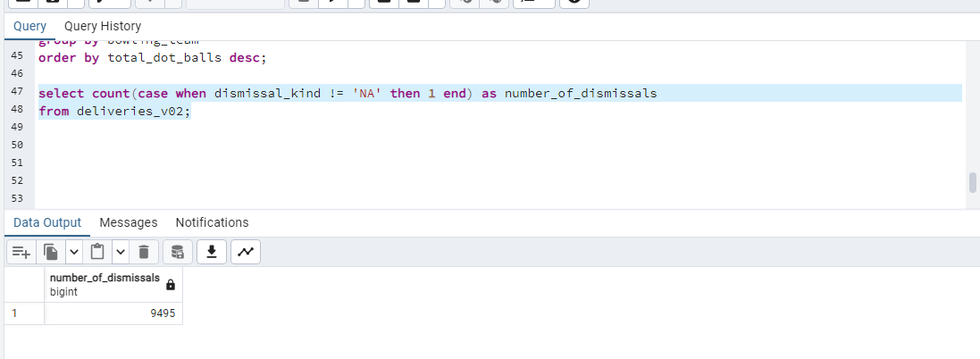
6. Write a query to fetch the total number of dismissals by dismissal kinds where dismissal kind is not NA
select count(case when dismissal_kind != 'NA' then 1 end) as number_of_dismissals
from deliveries_v02;

Slide 30
7. Write a query to get the top 5 bowlers who conceded maximum extra runs from the deliveries table
select bowler,
sum(extra_runs) as total_extra_runs
from ipl_ball
group by bowler
order by sum(extra_runs) desc
limit 5;

Slide 31
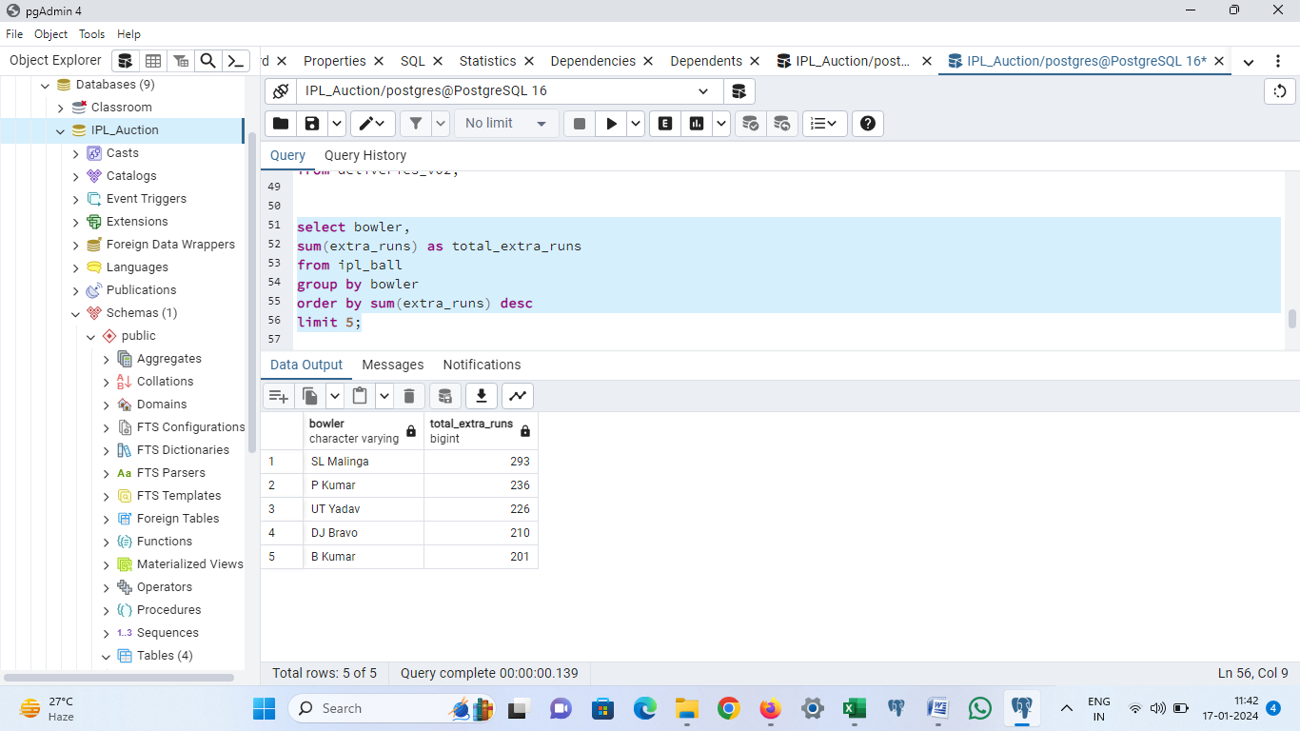

Slide 32
8. Write a query to create a table named deliveries_v03 with all the columns of deliveries_v02 table and two additional column (named venue and match_date) of venue and date from table matches
create table deliveries_v03 as
(select a.id,a.inning,a.over,a.ball,a.batsman,a.non_striker,a.bowler,a.batsman_runs,
a.extra_runs,a.total_runs,a.is_wicket,a.dismissal_kind,a.player_dismissed,a.fielder,
a.extras_type,a.batting_team,a.bowling_team,a.ball_result,b.venue,b.date as match_date
from deliveries_v02 as a
join ipl_matches as b
on a.id=b.id);

Slide 33
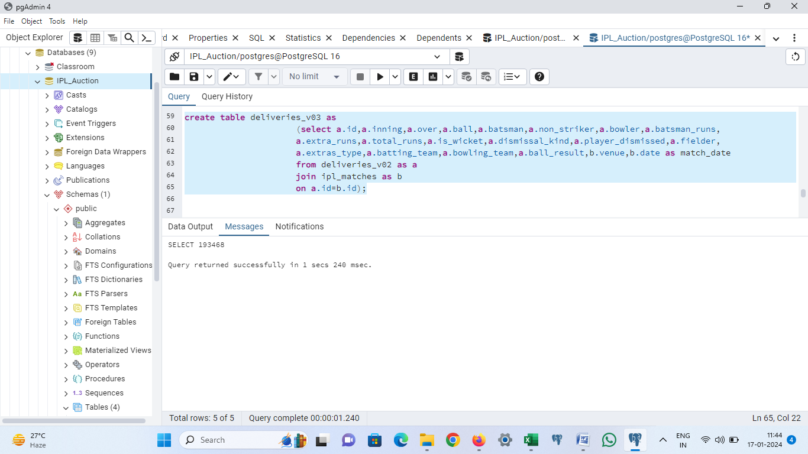

Slide 34
9.Write a query to fetch the total runs scored for each venue and order it in the descending order of total runs scored.
select venue,sum(total_runs) as total_runs
from deliveries_v03
group by venue
order by sum(total_runs) desc;

Slide 35
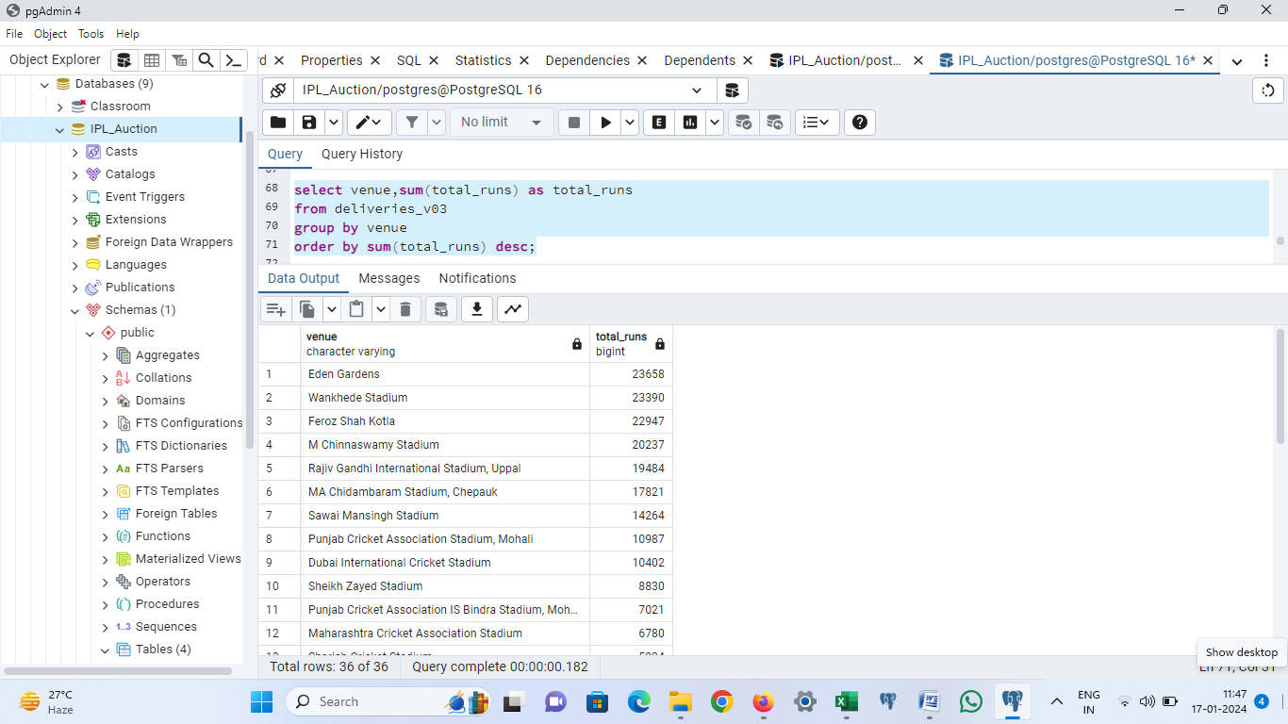

Slide 36
10. Write a query to fetch the year-wise total runs scored at Eden Gardens and order it in the descending order of total runs scored.
select extract(year from match_date) as year,sum(total_runs) as total_runs
from deliveries_v03
where venue='Eden Gardens'
group by extract(year from match_date)
order by total_runs desc;

Slide 37
